Slide 1
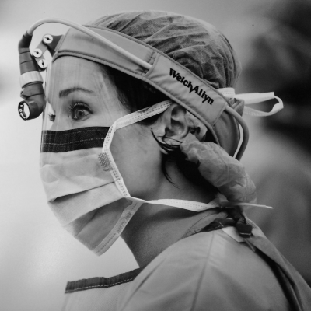
3rd Annual
Department of Surgery
Women in Surgery Lectureship
Jamie Jones Coleman, M.D., FACS
Associate Professor of Surgery at the University of Colorado School of Medicine
The ABC’s of WLB (Work Life Balance)
Dr. Coleman attended the University of Tennessee, graduating with a B.A. in History and subsequently completed medical school at the University of Tennessee, College of Medicine. Dr. Coleman then went onto to complete residency training in General Surgery at Rush University/Cook County Hospital followed by a fellowship training in Trauma and Surgical Critical Care at Grady Memorial Hospital with Emory University. Currently, Dr. Coleman is an Associate Professor of Surgery at the University of Colorado. Her clinical interests include research in stress physiology and sleep deprivation in physicians.

Slide 2
3rd Annual
Women in Surgery Lectureship
Year | Speaker | Institution | Topic
2018-19 | Rebecca Sippel, MD | University of Wisconsin | Redefining Success in Academic Surgery
2019-20* | Jamie Coleman, MD | University of Colorado | The ABC’s of WLB (Work-Life Balance)
2020-21 | Caprice Greenberg, MD | University of Wisconsin | From Evidence to Implementation: The Current State of Surgical Coaching
2021-22 | Julie Freischlag, MD | Wake Forest | TBD

Slide 3
3rd Annual
Department of Surgery
Women in Surgery Lectureship
Jamie Jones Coleman, M.D., FACS
Associate Professor of Surgery at the University of Colorado School of Medicine
The ABC’s of WLB (Work Life Balance)
Dr. Coleman attended the University of Tennessee, graduating with a B.A. in History and subsequently completed medical school at the University of Tennessee, College of Medicine. Dr. Coleman then went onto to complete residency training in General Surgery at Rush University/Cook County Hospital followed by a fellowship training in Trauma and Surgical Critical Care at Grady Memorial Hospital with Emory University. Currently, Dr. Coleman is an Associate Professor of Surgery at the University of Colorado. Her clinical interests include research in stress physiology and sleep deprivation in physicians.
Notes:
Dr. Jamie Jones Coleman is an acute care surgeon specializing in trauma, emergency general surgery, and surgical critical care at Denver Health Medical Center in Denver, Colorado and an Associate Professor of Surgery at the University of Colorado School of Medicine. She joined Denver Health in June of 2018 as the Director of Communications and Outreach for the Department of Surgery.
Prior to that, she was an Assistant Professor of Surgery at Indiana University where she served as director of media and public relations in the Department of Surgery.
She completed her general surgery residency in Chicago at Cook County Hospital and Rush University Medical Center.
Following her residency, she completed a trauma and surgical critical care fellowship at Grady Memorial Hospital in Atlanta, Georgia with Emory University.
She is active in multiple medical societies including the Eastern Association for the Surgery of Trauma (EAST) for which she has served as chair of Mentoring committee and Vice Chair of the Publications and Communications committee.
Her clinical research focuses on the physiologic impact of sleep deprivation, stress and burnout in surgeons. Her recent completed Surgeon Performance Trial is the largest study of continuous physiologic monitoring of acute care surgeons.
She has served as a writer for the Huffington post, has been a featured speaker on many podcasts and radio venues. She’s been interviewed on Good Morning America and is a well-known social media figure with over 45,000 followers on twitter. She has spoken on a wide array of topics from trauma to anti-racism to sleep deprivation in surgeons and gender based disparities in surgery.
Thank you for joining us today to speak on the ABCs of WLB- Work-Life Balance, Dr. Coleman.

